Slide 1
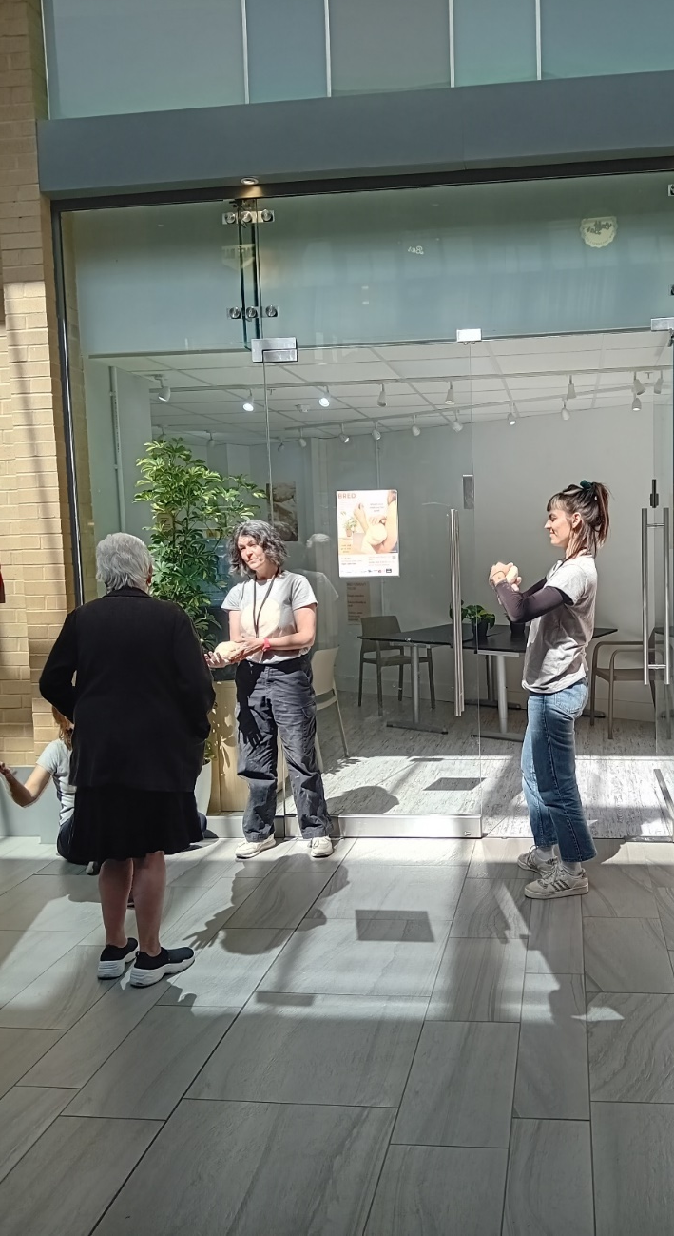


Making Meanwhile Space Work For You
A guide for creatives

Slide 2
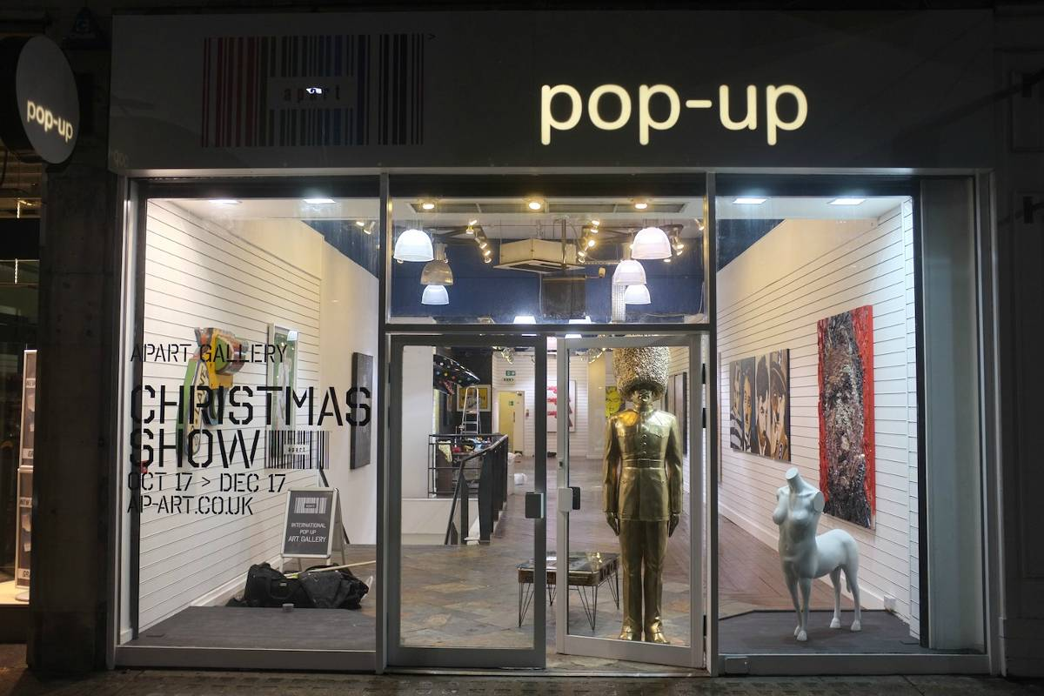
What Is Meanwhile Space?
‘Meanwhile’ is a term describing how a space (like a vacant shop unit) might be used temporarily while it is awaiting its’ next permanent tenant or another long-term use. It can be a great opportunity to try out new ideas and enliven an empty space, often at a very low cost.
Meanwhile uses include…
  Exhibitions
  Interactive performance
  Workshops
  Pop up shops
  Pop up venues
This pack will guide you through how to approach landlords regarding using their properties as meanwhile spaces.

Slide 3
What are the benefits to highlight to the landlord?
RATE RELIEF
If a vacant property becomes occupied for 3 months and 1 day (or longer) the owner is eligible for 3 months of vacant rate relief after that occupation, which is often a substantial sum.
For example, if your property has a rateable value of £20,000, the rate relief you could be entitled to would be £2,495 (calculated using https://www.gov.uk/calculate-your-business-rates).
More information can be found at https://www.gov.uk/apply-for-business-rate-relief/empty-property-relief
IMPROVED PERCEPTION
Occupation attracts attention - more people will be drawn to the area, and those who come will stay longer.
Busier areas feel safer and more vibrant, appearing more attractive to potential tenants.
Meanwhile events can generate positive press.
All of the above not only makes the unit in use more attractive to potential tenants, but also benefits other units in the vicinity. For example, if one vacant property on Barnstaple High Street was utilised for meanwhile activity, the increased footfall, dwell time, and overall perception would benefit other properties you manage on the street.
MAINTAINED/UPGRADED UNITS
Filling a space with activity makes it physically more attractive, with many projects also clearing and decorating spaces as part of their tenure.
Occupied units are less likely to attract anti-social behaviour in and around them, lowering the chance of damage to your property.

Slide 4
How does it work?
After initially approaching the landlord, arrange a viewing for the chosen property – make sure you take your time ensuring you are comfortable with the state of the property and that it is suitable for your needs. You should also be sure to confirm with the landlord that there is power and water for the property.
In exchange for enabling the rate relief, you can negotiate rent at a much reduced rate.
You become a temporary tenant in the chosen property.
The landlord may ask you to sign a tenancy agreement for 3 months and 1 day, triggering the rate relief period.
It should be agreed with that landlord that the power and water for the property are switched on in advance of the start of the tenancy.
You will curate your event/s in the space – make sure to share full information on the events taking place with the landlord, and ensure you have permission for any cleaning, clearing or decorating you’re doing.
The property should be left exactly as it was found (apart from any pre-agreed changes).
All events should have comprehensive marketing plans, and any logos or details for the landlord should feature on/in any promotional materials.
Upon your departure the landlord is eligible to claim their 3 months rate relief. This must be arranged directly with the local council.

Slide 5
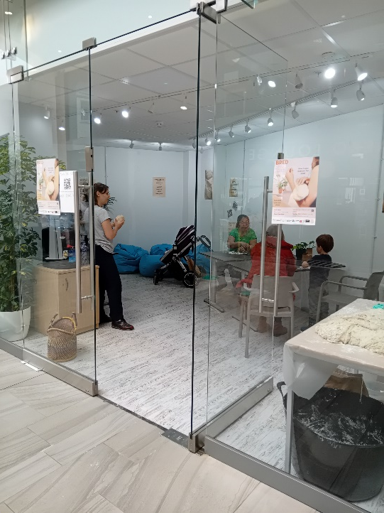
BRED: A Case Study
BRED was an interactive art project by performer Julia Pond, that was brought to a vacant shop unit in Barnstaple’s Green Lanes shopping centre from 24th to 28th May.
BRED was open to all ages and backgrounds from 11am-4pm each day and was free to access.
We have compiled this case study for you to share with landlords when approaching them if desired.

Slide 6
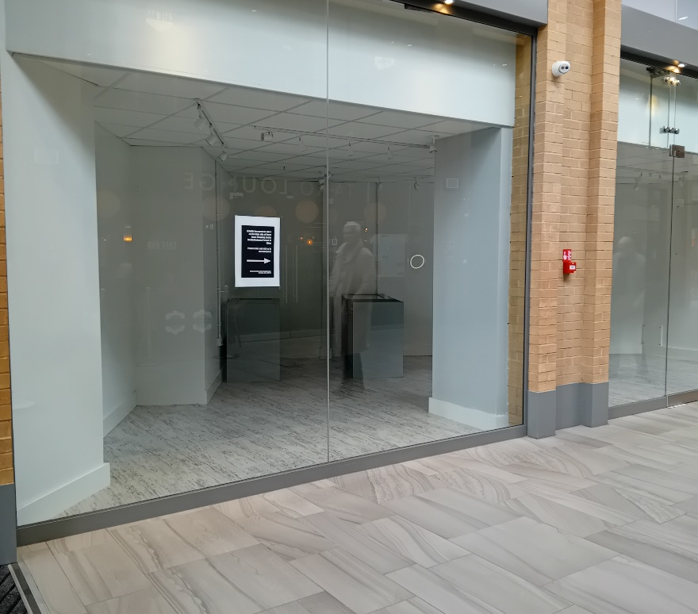
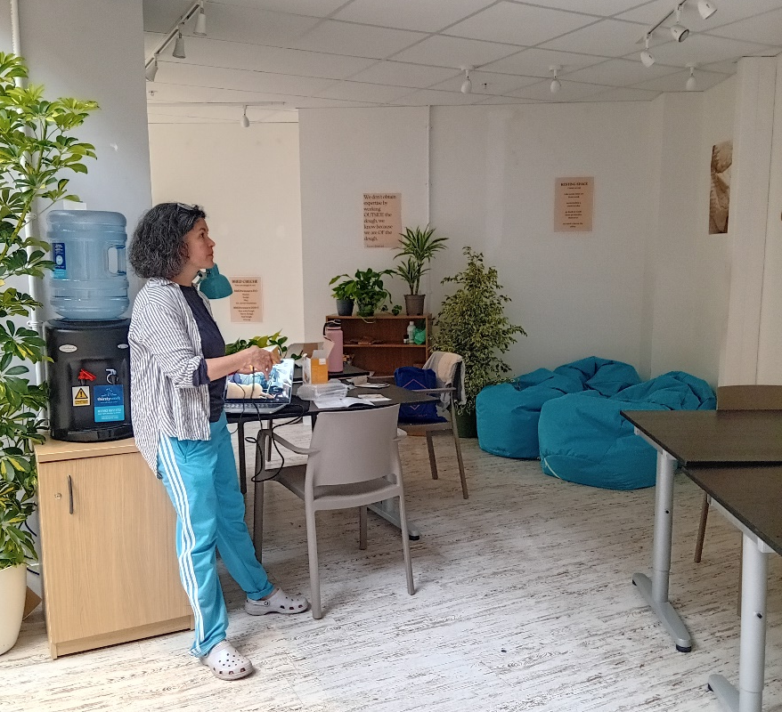
BRED: Key Statistics
BEFORE
Increased footfall - 240 people attended the event across 5 days
Increased dwell time - most of those who attended the performance did not know it was taking place before walking past
Positive perception - all those who completed a feedback form ranked the event as ‘very good’ or ‘excellent’
Supporting the local economy - the event partnered with 5 local organisations, 3 of which were local businesses
AFTER

Slide 7
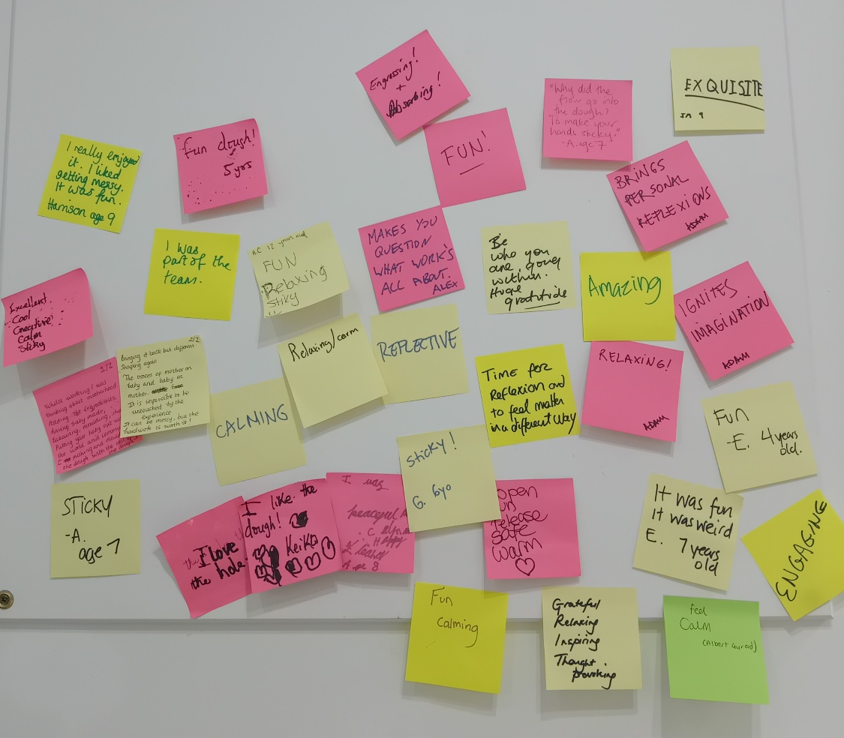
BRED: Audience Feedback
“It was a one of a kind experience”
“Very interesting experience to be part of the company and great to see a fresh perspective on work culture”
“[I] would like to see more of this”
“It [gave] space for beings to just be if they allow themselves to be free”

Slide 8



Thank you!

